Slide 1
50.001 Lesson 4

Slide 2


Slide 3


Slide 4
1D Project Checkoff 2
We are ok (chill) if you come with features uncompleted, bugs etc. Come and tell us your story.
Declare all sources -> it can be viewed positively
Checkoff 2 score depends on the rubrics -> what you present, how you present

Slide 5
What you did in Lesson 3
App to download/display an image from xkcd.com REST API
There are two threads – UI thread and background thread.
Download image – this task must run in background thread and communicate with UI thread when ready
How do you ensure that (a) the steps of an algorithm are executed in the correct order, but (b) allow certain steps to vary? – apply template method design pattern

Slide 6
Lesson 4 Plan
Session 1 – discuss Java and design Patterns
Session 2 – discuss Android framework
Session 3 – demo App
Week 11 Session 1 – wrap up and Lesson 5 intro

Slide 7
Lesson 4 Session 1
Static Inner Classes – for modelling data
Iterator Pattern – how to preserve information hiding for List
synchronized keyword – different threads updating the same resource
Adapter pattern – how to make one object have the interface of another

Slide 8
Iterator Pattern
import java.util.*; public class BadList { private List<Integer> integerList; BadList(){ integerList = new ArrayList<>(); }
// other code List<Integer> getIntegerList(){ return integerList; } }
How do you allow clients of your class to loop over it without telling them what you use to store the elements?
Information Hiding – hide implementation details from your client so that you have the flexibility to change if needed
In this example, by providing a getter for integerList, you are telling your client that you are using a List<> in your class. Since you are passing a reference through the getter, your client can use all the operations of List to modify your private variable.

Slide 9
Adapter Pattern
import java.util.ArrayList; public class Adapter { public static void main(String[] args) { List<Duck> duckArrayList = new ArrayList<>(); } } interface Duck{ void quack(); } interface Turkey{ void gobble(); }
If you are expecting objects of type A, how do you accept objects of type B? ( B is not related to A but have similar information that you want)
You have a List<> of Duck, how do you get it to accept Turkey objects?

Slide 10
Session 2

Slide 11
Recall Intents
Explicit Intent – from one activity to another
buttonSetExchangeRate.setOnClickListener( new View.OnClickListener() {
@Override
public void onClick(View view) {
Intent intent = new Intent(MainActivity.this, SubActivity.class);
startActivity(intent);
}
});

Slide 12
Recall Intents
Implicit Intents – specify an action + data, ask Android to launch the component available, which may vary between phones
Uri geolocation = ; // URI
Intent intent = new Intent(Intent.ACTION_VIEW);
intent.setData(geolocation); // Data
startActivity(intent);

Slide 13
What we are doing with intents
Previously, you specified an intent to go from one part to another without expecting a result to be returned e.g. MainActivity to SubActivity MainActivity to Google Maps
Now we will show you how to write intents that will return a result e.g. MainActivity to ImageGallery to pick a photo

Slide 14
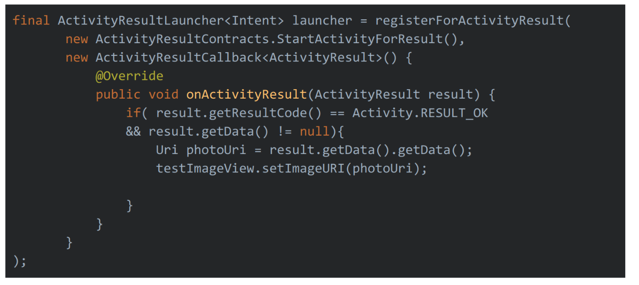
Step 1 Write a Launcher -> what to do with the result
ActivityResultLauncher<Intent> launcher = registerForActivityResult( ActivityResultContract object , ActivityResultCallback object )
Launcher specifies what will happen when the result (i.e. image selected) is received.

Slide 15
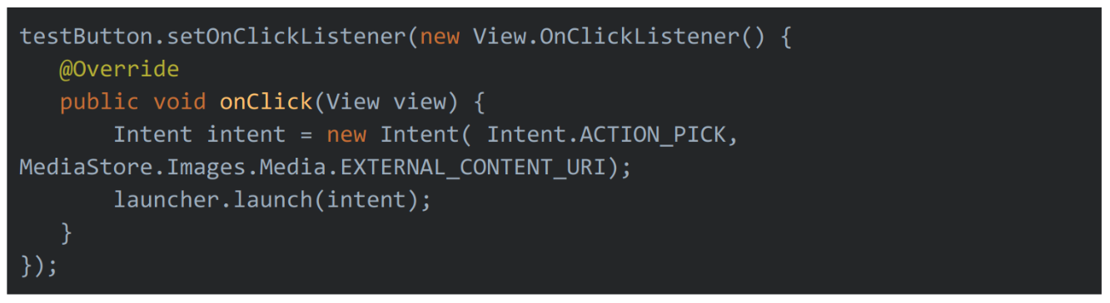
Step 2 – Write the Intent -> tell android where to go to get the result
Remember, implicit intent requires action + data

Slide 16



Problem - Displaying a list of data in your app
You have a database and you want to display its contents as a list of identical layouts
Image | Description | Price
 | Smart Car | $10000
 | London Taxi | $20000
 | Retro Car | $5000
Smart Car
$10000
London Taxi
$20000
Retro Car
$5000
Phone
The widget that displays a list of identical layouts is a RecyclerView
Images from rawpixel.com
Database (on the cloud, on the phone etc)

Slide 17
Solution - High level overview of RecyclerView
ImageView
TextView Description
Design how each identical layout will look like and decide which information goes where.
Write a class that has the data you want e.g. after querying the database.
Write the RecylerView adapter to specify the layout and to say which piece of data goes to which widget
On your Activity, instantiate the RecyclerView widget, specify the adapter and layout.
Android takes care of looping through your data and creating each list item, enabling scrolling etc
TextView Price
class Data{
//other code
… getImage(int i){ … } … getDescription(int i){…}
… getPrice(int i){…}
}
class Adapter extends … {
//other methods
onBindViewHolder(int position){ … textViewPrice.setText( data.getPrice(position));
//code for other widgets
}
}

Slide 18
In-Class Demo

Slide 19
Example App - Words
2. Write a class that gets the data.
public interface WordsDataSource { void addWord(String s); String getWord(int i); void removeWord(int i); int getSize(); }
1. Design the layout of each item.
<LinearLayout xmlns:android="http://schemas.android.com/apk/res/android" android:layout_width="wrap_content" android:layout_height="wrap_content" android:orientation="vertical"> <TextView android:layout_width="match_parent" android:layout_height="wrap_content" android:id="@+id/textViewWord" android:textSize="24dp" android:gravity="center_horizontal" android:text="default" /> </LinearLayout>

Slide 20
3. Write the adapter – First write an inner class to hold reference(s) to each View on each list item layout
public class WordsAdapter extends RecyclerView.Adapter<WordsAdapter.WordsHolder> {
// irrelevant details hidden class WordsHolder extends RecyclerView.ViewHolder{ private TextView textView; public WordsHolder(@NonNull View itemView) { super(itemView); textView = itemView.findViewById(R.id.textViewWord); } public TextView getTextView() { return textView; } } }

Slide 21
3. Adapter - next, override the methods onBindViewHolder is the most important
public class WordsAdapter extends RecyclerView.Adapter<WordsAdapter.WordsHolder> { //other details hidden WordsDataSource data; WordsAdapter(Context context, WordsDataSource wordsDataSource){ } @NonNull @Override public WordsHolder onCreateViewHolder(@NonNull ViewGroup parent, int viewType) { //standard code View itemView = mInflater.inflate(R.layout.layout, parent, false); return new WordsHolder(itemView); } @Override public void onBindViewHolder(@NonNull WordsHolder holder, int position) { } @Override public int getItemCount() { return 0; // change this! } class WordsHolder extends RecyclerView.ViewHolder{ // see previous slide for the details } }

